Slide 1
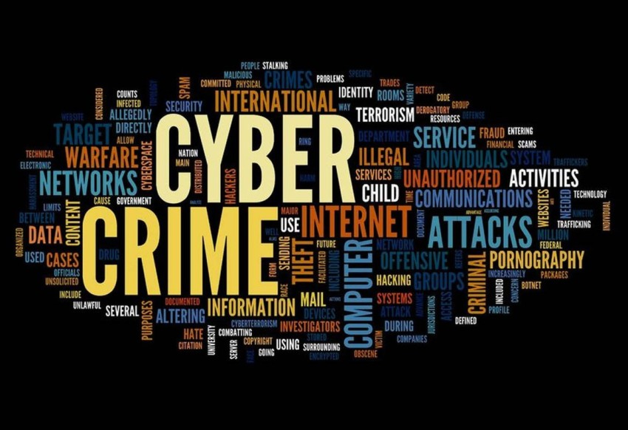
CYBER CRIME
Presented by:- Kundan Gawande(28806)

Slide 2
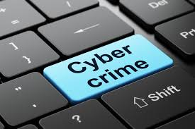
What is Cybercrime?
Cybercrime can be defined as “The illegal usage of any communication device to commit or facilitate in committing any illegal act”.
A cybercrime is explained as a type of crime that targets or uses a computer or a group of computers under one network for the purpose of harm.
Cybercrimes are committed using computers and computer networks. They can be targeting individuals, business groups, or even governments.

Slide 3

Who are The Cybercriminals?
Cybercriminal is a person who uses his skills in technology to do malicious acts and illegal activities known as cybercrimes. They can be individuals or teams.
Cybercriminals are widely available in what is called the “Dark Web” where they mostly provide their illegal services or products.

Slide 4

How do Cybercrimes happen?
Cybercriminals take advantage of security holes and vulnerabilities found in systems and exploit them in order to take a foothold inside the targeted environment.
The security holes can be a form of using weak authentication methods and passwords, it can also happen for the lack of strict security models and policies.

Slide 5
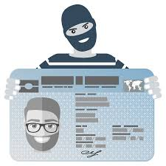
Most Common Cyber Crimes
1. Phishing and Scam:
Phishing is a type of social engineering attack that targets the user and tricks them by sending fake messages and emails to get sensitive information about the user or trying to download malicious software and exploit it on the target system.
2. Identity Theft
Identity theft occurs when a cybercriminal uses another person’s personal data like credit card numbers or personal pictures without their permission to commit a fraud or a crime.

Slide 6

3. Ransomware Attack
Ransomware attacks are a very common type of cybercrime. It is a type of malware that has the capability to prevent users from accessing all of their personal data on the system by encrypting them and then asking for a ransom in order to give access to the encrypted data.
4. Hacking/Misusing Computer Networks
This term refers to the crime of unauthorized access to private computers or networks and misuse of it either by shutting it down or tampering with the data stored or other illegal approaches.
5. Internet Fraud
Internet fraud is a type of cybercrimes that makes use of the internet and it can be considered a general term that groups all of the crimes that happen over the internet like spam, banking frauds, theft of service, etc.

Slide 7
Cyber Crimes Examples
REvil and Kaseya Ransomware
REvil is a Russian or Russian-speaking hacking group and it is known as a ransomware-as-a-service operation. The Kaseya incident took place in July - 2021.
The incident happened when one of the Kaseya's company's products was deploying the famous SODINOKIBI REvil ransomware to endpoints of Kaseya's customer network that attack surface was over 1000 Kaseya's customers worldwide.
A few hours later REvil took credit for the attack by posting on their Happy Blog website on the dark web and demanded a $70 million ransom to release a public decryptor that they claim can decrypt all the damaged devices.
The attack was so impactful that the United States government offered $10 million bounties to anyone that can give any information for arresting REvil members.

Slide 8
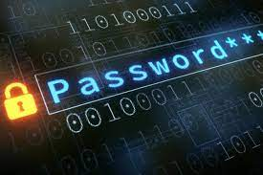

Slide 9
How to Prevent Cybercrimes?
1. Be sure that you are using up-to-date security software like antivirus and firewalls.
2. Implement the best possible security settings and implementations for your environment.
3. Don't browse untrusted websites and be careful when downloading unknown files, and also be careful when viewing Email attachments.
4. Use strong authentication methods and keep your passwords as strong as possible. You can find in this article tips on how to protect your password.
5. Don’t share sensitive information online or on your social media accounts.
6. Educate your children about the risks of internet usage and keep monitoring their activities.

